Slide 1


CAPSTONE II:
SPOILER BLOCKER EXTENSION
April 2024

Slide 2
TABLE OF CONTENTS
Project team
Introduction
Methodology
Project Objectives
Technical Architecture
Cloud service
03
04
05
08
19
21

Slide 3

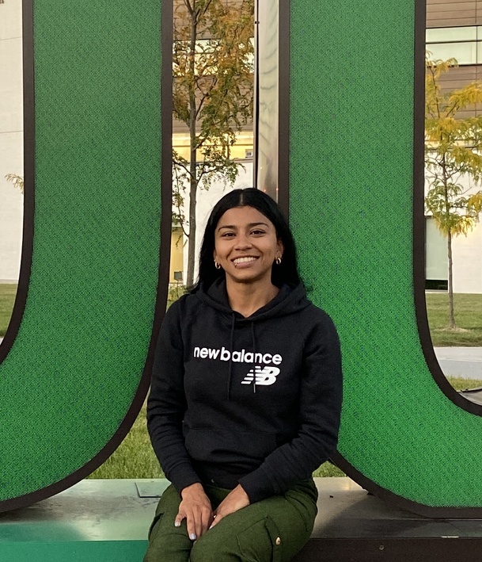
PROJECT TEAM
FELICITY OGUNTOLU
KAROL CARDENAS

Slide 4
INTRODUCTION
A web browser extension is software that adds custom functions and features to your browser. It is created using the same technologies used in creating web pages -
HTML, CSS, JavaScript.
AIM: Building a Spoiler blocker extension.
Like the need for many blocker extensions e.g. ads, inappropriate content, etc. People also find the need to hide spoilers of their favorite shows or movies from showing up randomly while using their browsers.

Slide 5
METHODOLOGY
To build any software, there are some key technologies to always consider
Programming Languages
Frameworks and Libraries
Databases

Slide 6




METHODOLOGY
HTML
CSS
JAVASCRIPT
Building block for all websites; standard markup language used to create apps, web interfaces, etc.
Style sheet language to set the style and deisgn of HTML elements
Programming language to create interactive effects within web browsers

Slide 7
METHODOLOGY
PYTHON
API’S
DATABASE
For implementing the AI component, python is need for coding the ML models e.g. NLP, Sentiment analysis
Interface needed to support complex operations and access data e.g. database of spoliers
A regular updated and maintained database can only be achieved with a management system like MySQL to keep track of chnages, aid ease of updates, etc.

Slide 8

PROJECT OBJECTIVES
01
02
03
04
05
Keyword
Filtering
Database of Spoilers
Content
Replacement
Customer-user
settings
Natural Language Processing (NLP)

Slide 9
GITHUB REPOSITORY

Slide 10
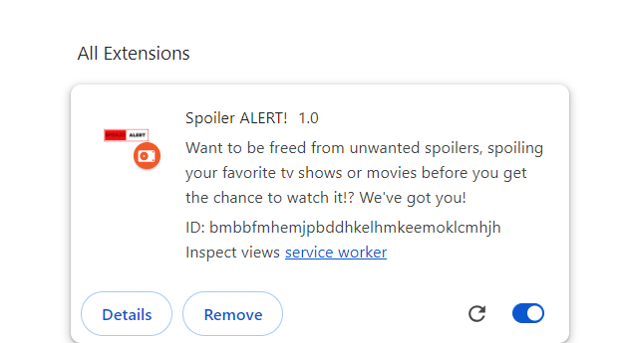
SPOILER BLOCKER EXTENSION

Slide 11
PROJECT OBJECTIVES
Basic Features
Keyword Filtering
This is a Natural Language Processing (NLP) technique that involves detecting and filtering desired/undesired information from a sequence of text.
This project, involves filtering out specific words or phrases that are related to TV series and/or movies, this functionality is important as these words/phrases usually lead to more spoiler formats like images and videos of content you do not want to see.

Slide 12
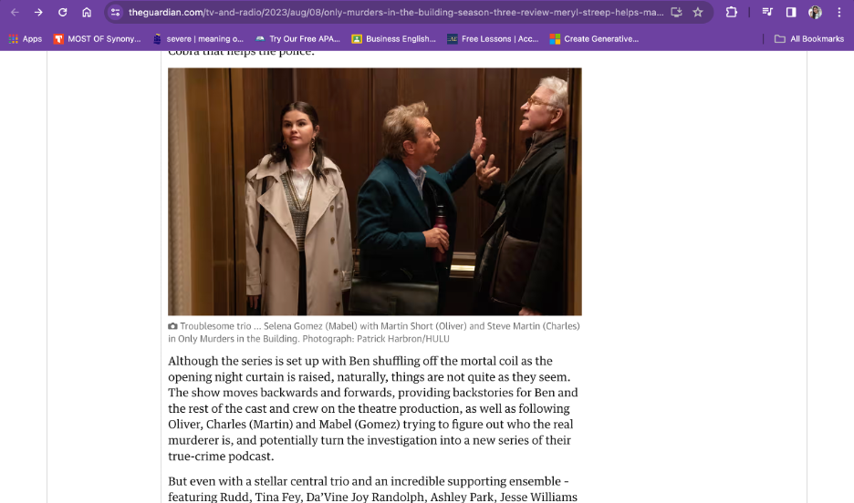
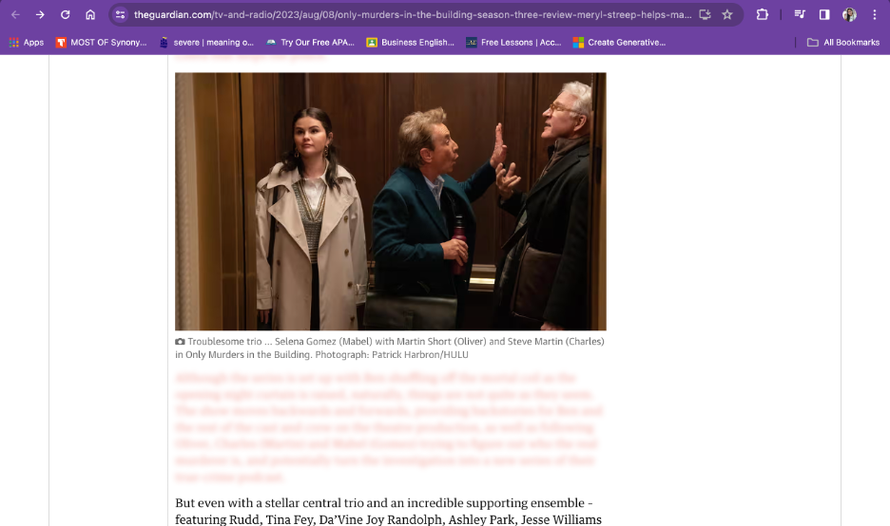
PROJECT OBJECTIVES
Basic Features
Keyword Filtering

Slide 13
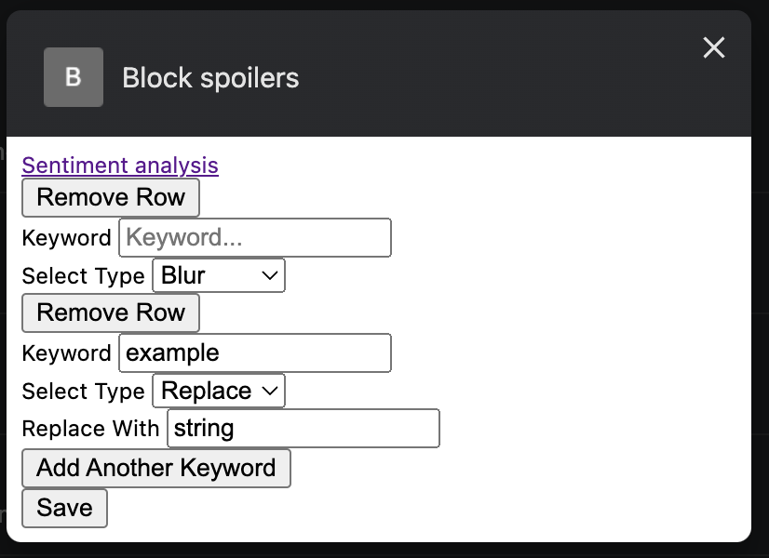
PROJECT OBJECTIVES
Basic Features
Keyword Filtering

Slide 14
PROJECT OBJECTIVES
Spoiler database
This is an organized collection of spoiler-related data like words, and phrases related to TV/film e.g. character names, popular quotes from the film, media, discussion topics of key scenes in the movie or TV, common spoiler phrases, etc.
A database is essential for this software because of the need to access, manage, and update spoiler content, new and old, some of which may arise from keyword filtering.

Slide 15
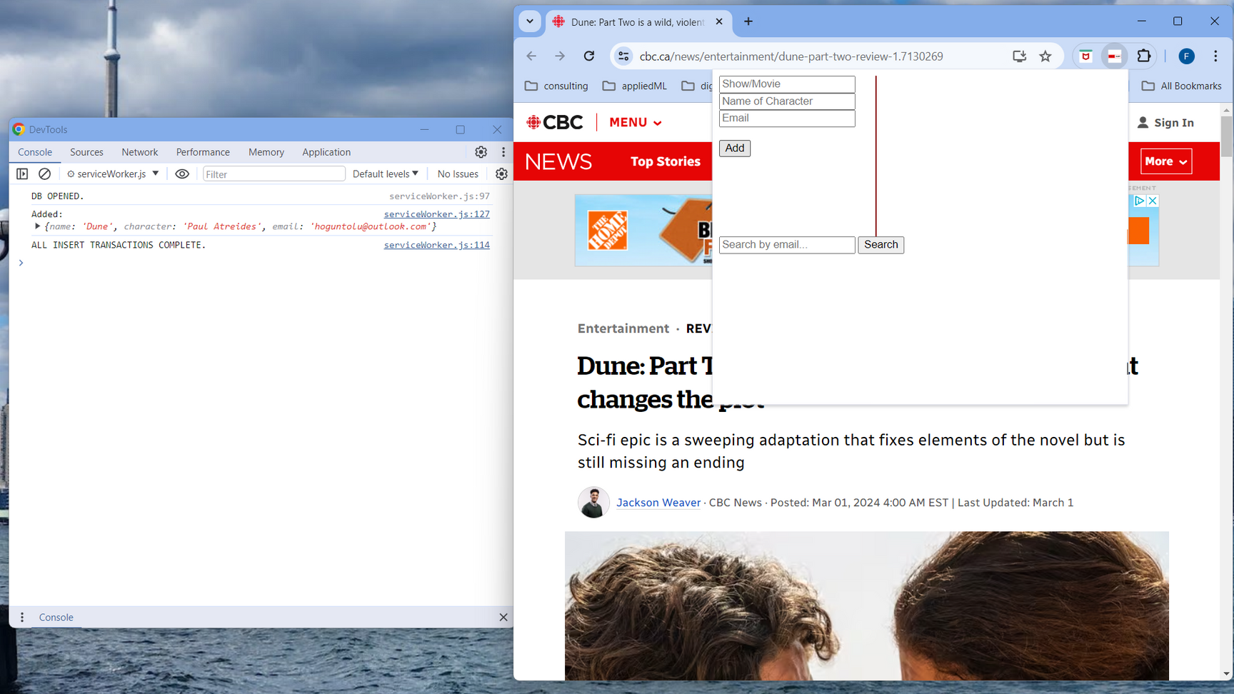
PROJECT OBJECTIVES
Insert and show record in database

Slide 16
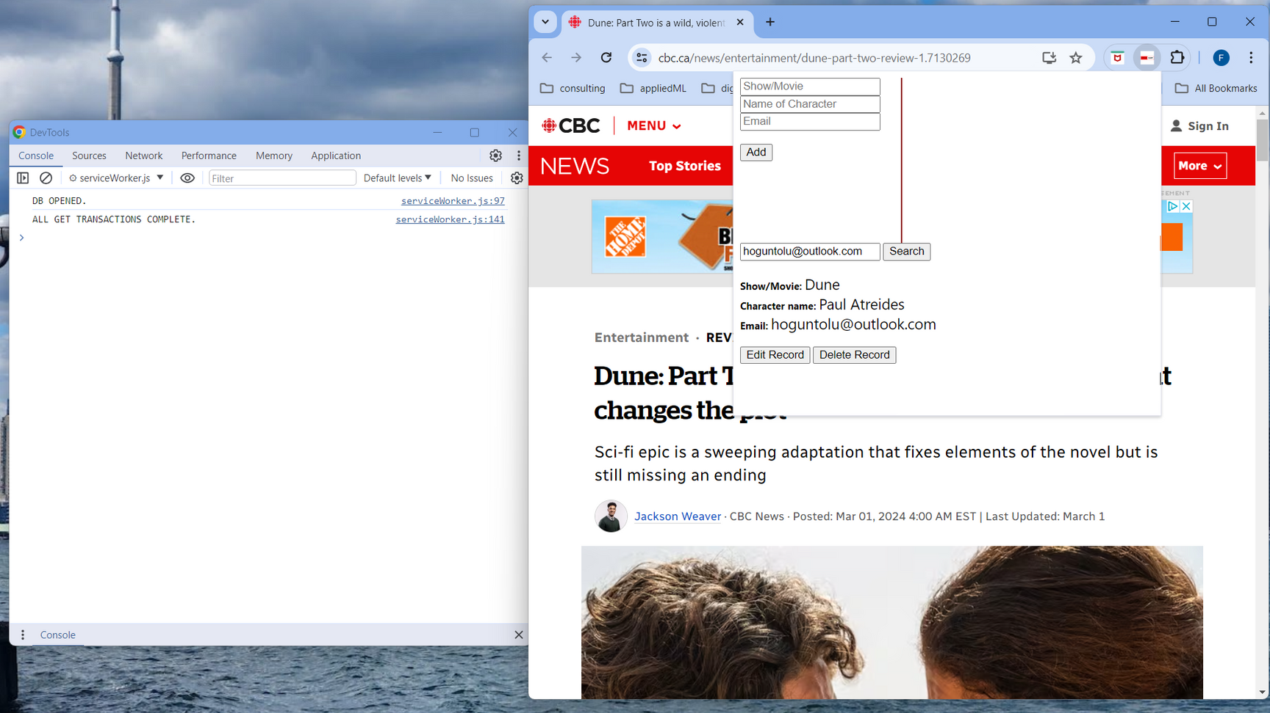
PROJECT OBJECTIVES
Retrieve a record from database

Slide 17
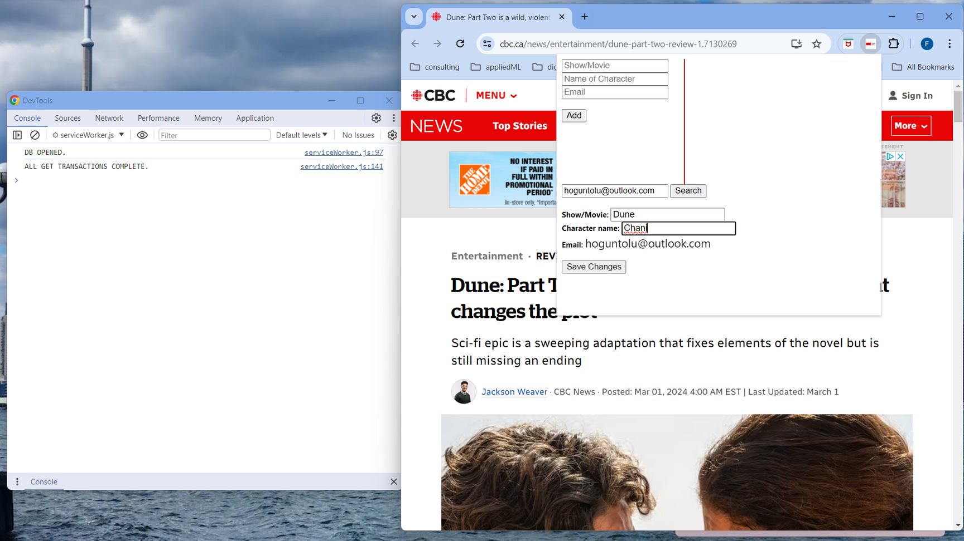
PROJECT OBJECTIVES
Edit a record from database

Slide 18
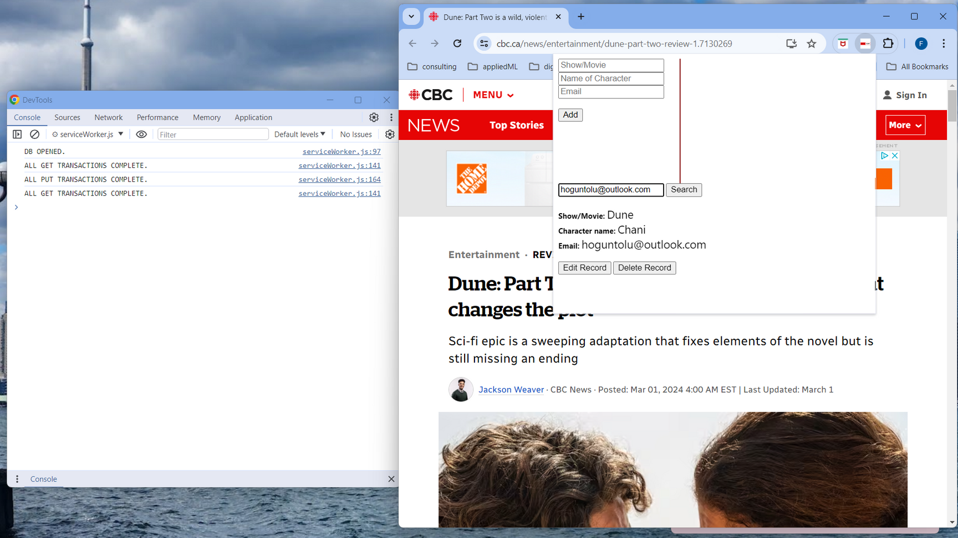
PROJECT OBJECTIVES
Edit a record from database

Slide 19
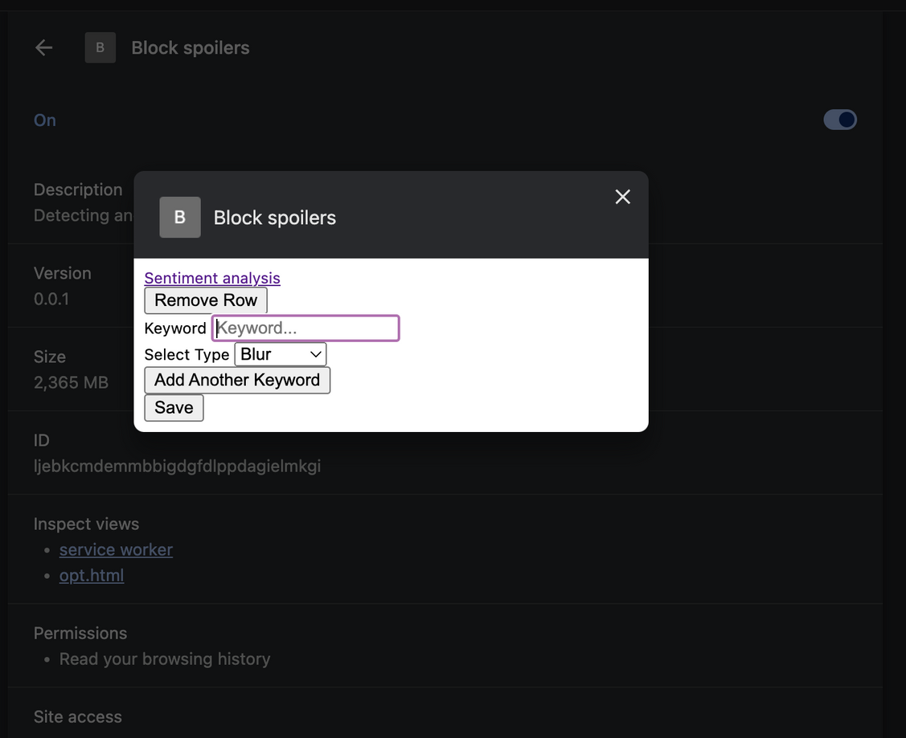
PROJECT OBJECTIVES
Basic Features
Custom user settings:

Slide 20
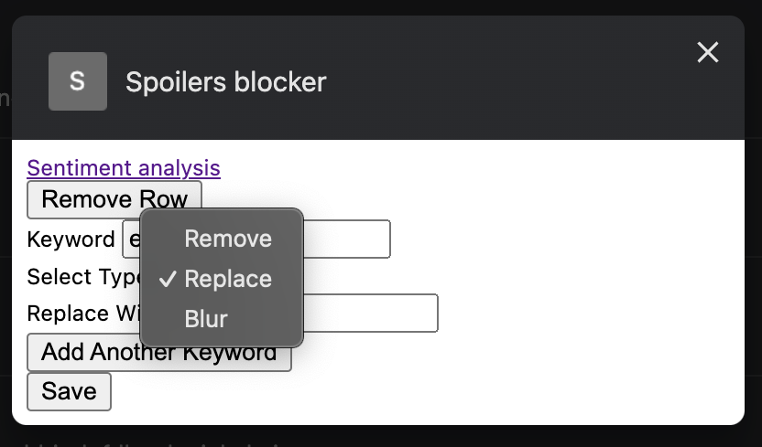
PROJECT OBJECTIVES
Basic Features
Constent replacement:

Slide 21
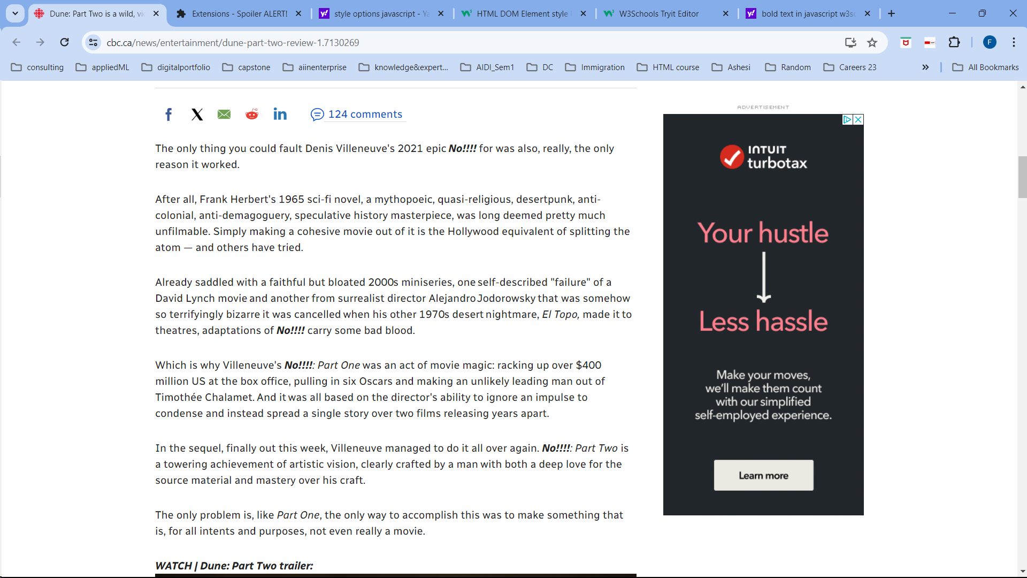
PROJECT OBJECTIVES
Content replacement- text

Slide 22
PROJECT OBJECTIVES
Content replacement- blurring effect

Slide 23
PROJECT OBJECTIVES
Advanced Features
Natural Language Processing (NLP)
Classify and analyze the reviews or comments of other users on the internet.

Slide 24
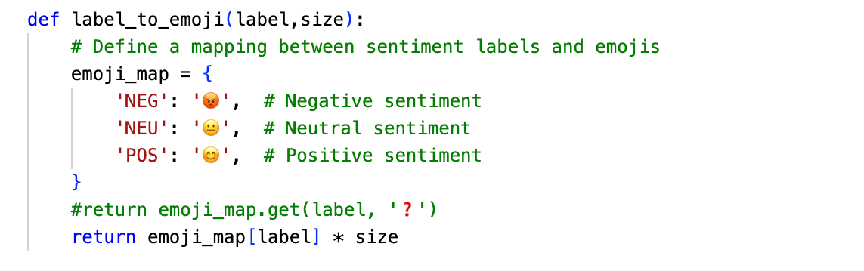
PROJECT OBJECTIVES
Advanced Features
Natural Language Processing (NLP)
Sentiment analysis model.

Slide 25
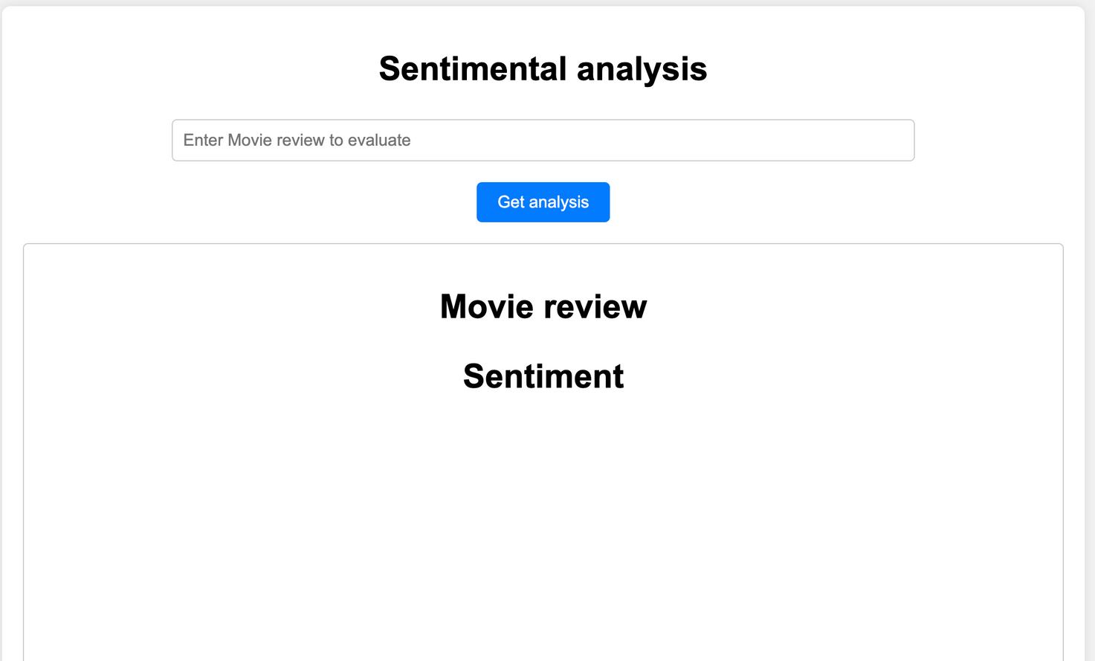
PROJECT OBJECTIVES
Sentiment analysis API

Slide 26
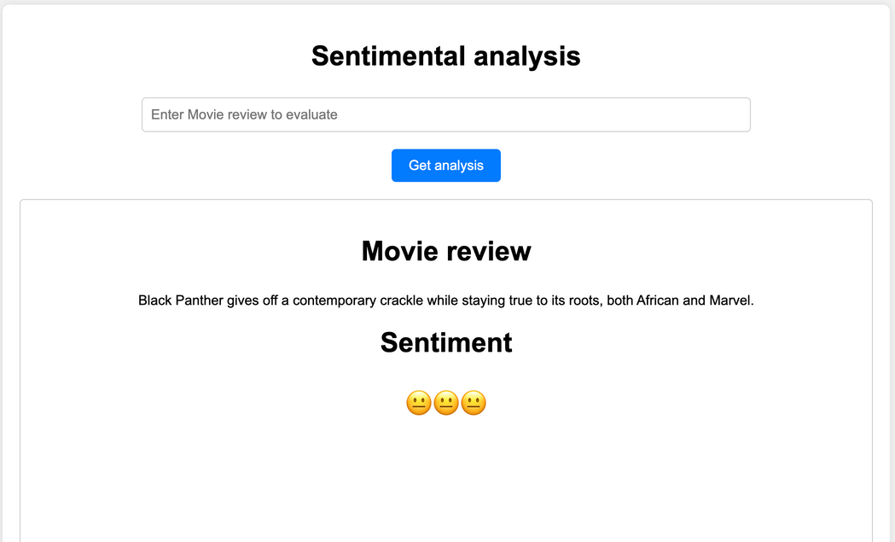
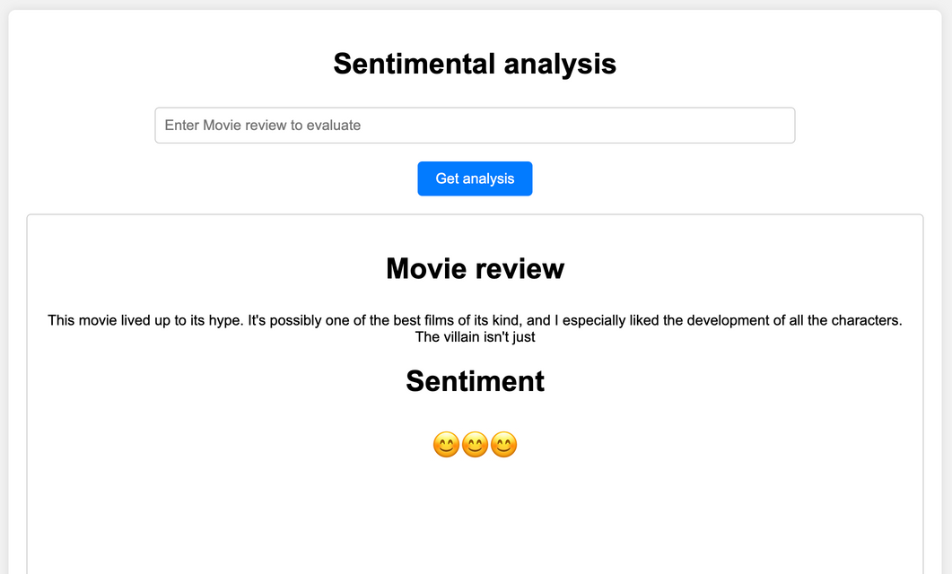
PROJECT OBJECTIVES
Sentiment analysis model.
Classification

Slide 27

DISTRIBUTE EXTENSION
Chrome Web Store is an online marketplace for Chrome extensions and themes.

Slide 28

THANK YOU!

